Slide 1
CS3210 Tut 4
Quiz 1 & 2 Review + Some Assignment 2 & CUDA extras
Slides inspired from Sriram
+ extra tidbits

Slide 2
Quiz 1

Slide 3
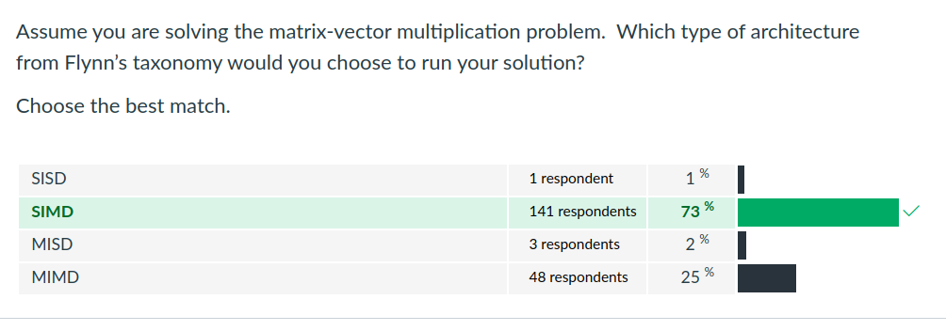
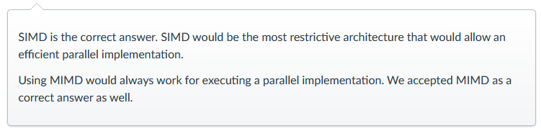
Q7: SIMD and MIMD problems

Slide 4
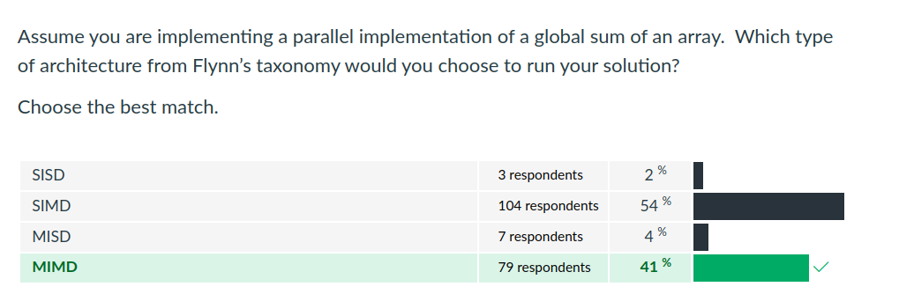
Q8: SIMD and MIMD problems

Slide 5
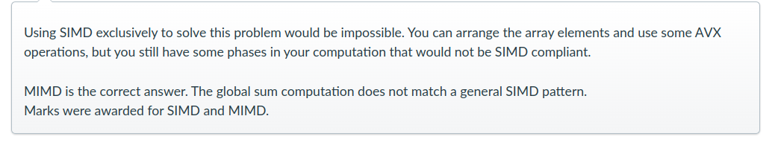
Q8: SIMD and MIMD problems

Slide 6
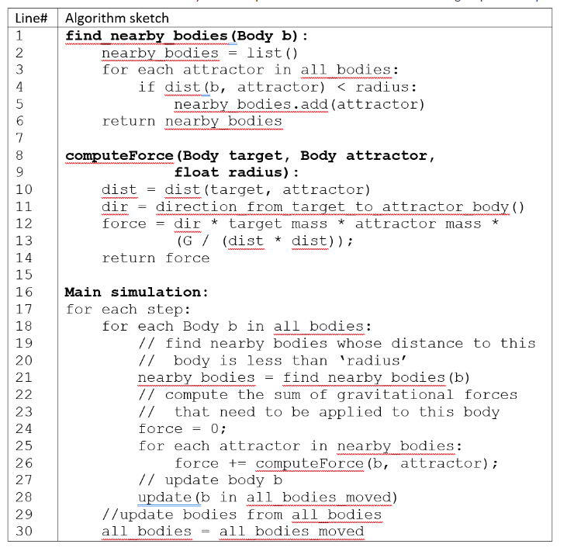
Q9-Q13
Understanding the problem

Slide 7
Q9-Q13
Understanding the problem
Multiple sim steps
Each step simulates the forces to apply on each "body" due to gravity (from nearby bodies)
Iterate through all bodies to compute forces based on distances from nearby bodies.

Slide 8
Q9 + Q10
Data or Task Parallel?

Slide 9
Q9 + Q10
Data or Task Parallel?
Data parallelism describes this problem better.
Same set of instructions applied to different bodies
However, this does not mean it's SIMD!
Within main simulation, there are no heterogeneous tasks that can be executed in parallel.

Slide 10
Skipping ahead: Q13
How to parallelize with OpenMP?
Add #pragma omp parallel for above line 18.

Slide 11
Skipping ahead: Q13
How to parallelize with OpenMP?
Add #pragma omp parallel for above line 18.
Common mistake: Nested #pragma omp for: undefined behaviour.
Common non-mistake: using explicit barriers - OpenMP syncs threads at the end of blocks implicitly (no penalty for this).

Slide 12
Skipping ahead: Q13
Adding #pragma omp critical/ atomic to line 28, needed?

Slide 13
Skipping ahead: Q13
Adding #pragma omp critical/ atomic to line 28, needed?
Depends! Can assume that the update statement writes to different locations in memory - no synchronization needed!

Slide 14
Q11+Q12
Parallel patterns?
Parbegin-parend
Pipeline
Task pool
SIMD
Master-worker
SPMD
Producer-consumer
Fork-join

Slide 15
Q11+Q12
Point to think about:
Is the number of nearby_bodies the same for every body?

Slide 16
Q11+Q12
Point to think about:
Is the number of nearby_bodies the same for every body?
No! Splitting all_bodies to execute SIMD cannot work because each body may have different no. of instructions.

Slide 17
Q11+Q12
Parallel patterns?
Master-worker: homogeneous work for worker, master can coordinate between steps.
parbegin/end, fork-join, SPMD, etc should be OK for similar reasons.
Task Pool: tasks are fairly homogeneous, task-fetching overhead unnecessary. (½ credit)
No SIMD, Producer-Consumer, Pipeline.

Slide 18
Quiz 2

Slide 19
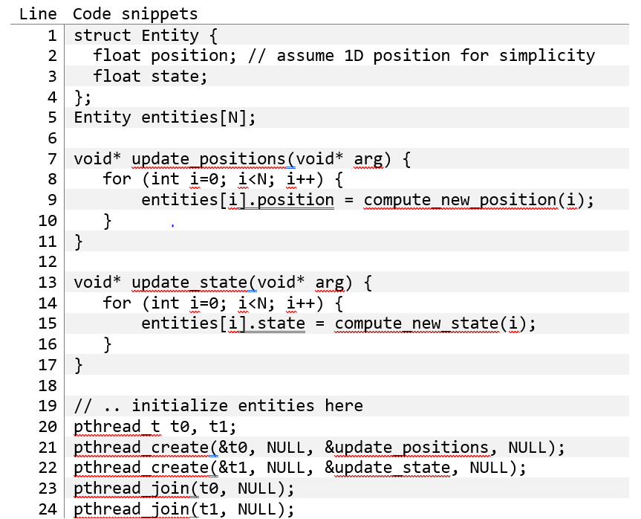
Q1+2
Understanding the problem

Slide 20
Q1+2
Understanding the problem
Two threads, both updating values within an array of structs
For each struct,
One thread changes the position variable
One thread changes the state variable

Slide 21
Q1
Why don't we get 2x speedup?

Slide 22
Q1
Why don't we get 2x speedup?
Classic false sharing
Both threads (if running at the same rate) are writing to the same entity
That's OK, but position and state are (likely) part of the same cache line!!

Slide 23
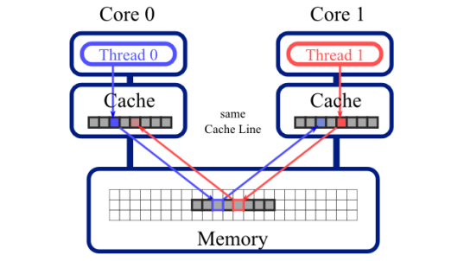
Recap: False Sharing
Two cores update different data that happens to be part of the same cache line!
Due to cache coherence, the data must be written back to memory, and then written to the other core's cache, even if not strictly needed!

Slide 24
Q2
How to solve (at least 3 ideas)?

Slide 25
Q2
How to solve (at least 3 ideas)?
Have two separate arrays:
float position[N]
float state[N]

Slide 26
Q2
How to solve (at least 3 ideas)?
Have two separate arrays:
float position[N]
float state[N]
Have padding between position and state to put them in diff cache lines
e.g. add a field like char pad[PAD_BYTES]

Slide 27
Q2
How to solve (at least 3 ideas)?
Have two separate arrays:
float position[N]
float state[N]
Have padding between position and state to put them in diff cache lines
e.g. add a field like char pad[PAD_BYTES]
Make one thread iterate 0 → N the other thread iterate N/2 → wraparound to 0 → N/2-1

Slide 28
Q4
Relaxed consistency models address the concern that software complexity is increased by the need for unnecessary synchronization.

Slide 29
Q4
Relaxed consistency models address the concern that software complexity is increased by the need for unnecessary synchronization.
False: relaxed consistency does not address software complexity
Relaxed consistency exists to increase performance of programs (i.e. allows programmers to write faster code)
Doing so can actually increase the software complexity even further!

Slide 30
Q6
Cache coherence is the property that multiple caches contain the same set of items. Is this statement true or false?

Slide 31
Q6
Cache coherence is the property that multiple caches contain the same set of items. Is this statement true or false?
False: Caches do not have to contain the same set of items.
We just need to make sure that the specific cache lines that is being accessed by multiple processes is in sync

Slide 32
Assignment 2 Overview

Slide 33
Assignment Overview: Virus Signatures
stdout:
(one line per virus matched to database)
tests/filename1: virusname
tests/filename1: virusname2
tests/filename2: virusname3
…
(Order does not matter)
Virus signature database
Linux.ELF-420:7f454c460201be
Win.Trojan.Small-4379:606a026a01e8??000000
….
Your program that runs CUDA kernel(s)
Input file
<binary data containing 0 - 5 virus signatures, parsed for you>
Input file
<binary data containing 0 - 5 virus signatures, parsed for you>
More input files ….
You are going to be matching binary signatures (a string of bytes) to a database of known viruses (many strings of bytes)
Your job: find viruses (essentially: substring matches)
Deadline: 26 October (next week's Thursday)

Slide 34
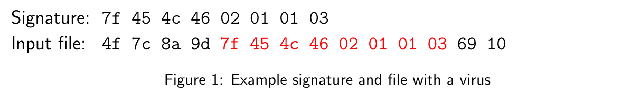
Finding Viruses (1)
First kind of virus-signature match: exact match (6 marks)
The sequence of bytes in the signature matches a virus in an input file

Slide 35
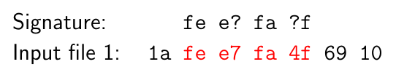
Finding Viruses (2)
Second kind of virus-signature match: wildcard match (2.5 marks)
The sequence of bytes in the signature contains ? characters
? can match any nibble (½ a byte, 1 hex character)

Slide 36
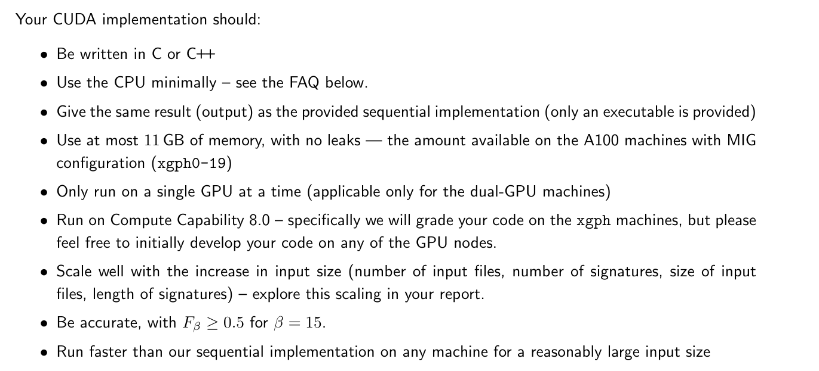
Grading

Slide 37
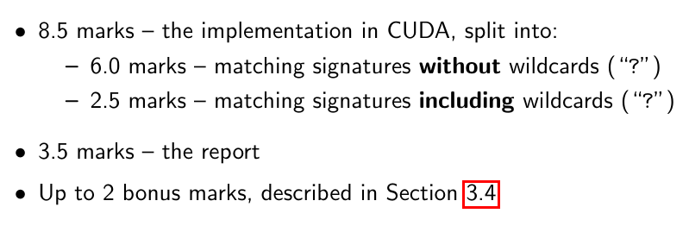
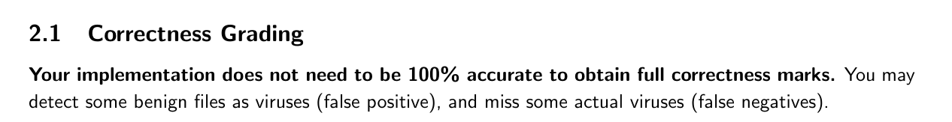
Grading
Multiple approaches
Brute force algorithm (100% accuracy)
Non-exact algorithm: GPUGems, etc
But fancy algorithms may not be interesting to parallelize on the GPU

Slide 38
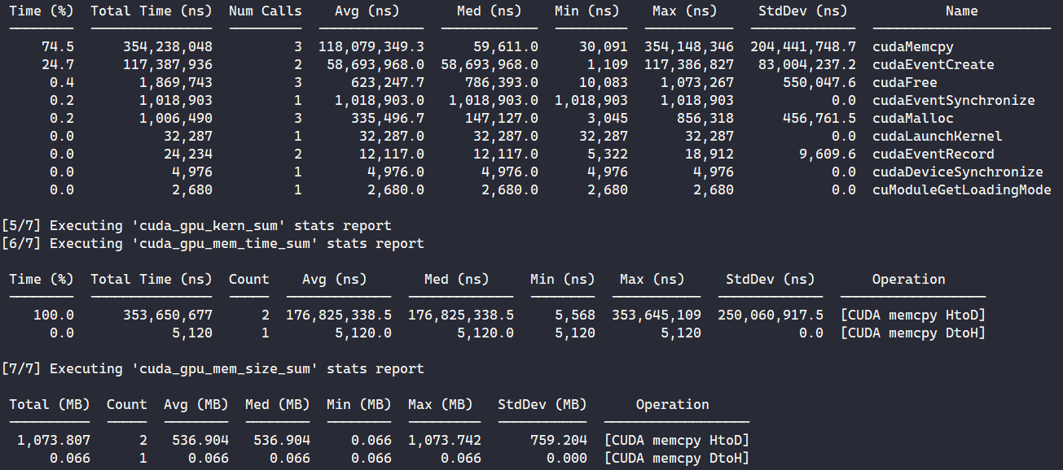
Profiling on a100/a100mig
Easiest option that we’ve discovered with the new CUDA profilers: srun -G a100mig nsys nvprof ./executable
Feel free to explore ncu / nsys to profile

Slide 39
Lots of starter code
Slurm script - immediately works to run and check your code
Generate test cases (./gen_tests.py)
Run your implementation vs sequential (./check.py)
Sequential executable (./scanner-seq)
Many existing tests (tests/)

Slide 40
Announcement
(Just blasted out at 1:05pm just now)
We just pushed out an update to the GitHub Classroom template code to fix some bugs with the provided sequential implementation executable.
If you have not created your repo on GitHub Classroom yet: No action required. Do start your assignment soon :)
If you have created your repo already: new code "cs3210-a2-starter-v2.zip" should be uploaded to Canvas - update your repo with the new check.py and scanner-seq files!

Slide 41
Note (not in the assignment sheet)
May run into the following error when executing commands on xlogin: fatal: client_io_handler_start: pthread_create error Resource temporarily unavailable
SoC limits no. of processes you can run on each login node.
Simply list all the processes you're running with ps -u $USER
Then kill processes that you don't need with pkill, kill or killall.

Slide 42
Extra Topic: Bitonic Sort in CUDA

Slide 43
Bitonic Sort (PYP question)
Great algorithm for massively parallel sorting
Relies on merging bitonic sequences: a series of numbers that are
Increasing for the first half
Decreasing for the second half
O(n log² n) ⇒ Slower than the fastest sorts serially, but massively parallel

Slide 44
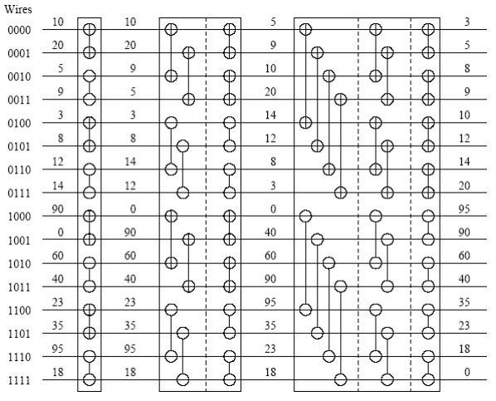
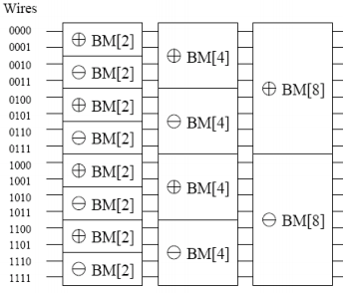
CUDA?
Why is this parallelizable and ideal for CUDA?

Slide 45
CUDA?
Same no. of threads (N/2) doing same no. of comparisons in each step!

Slide 46
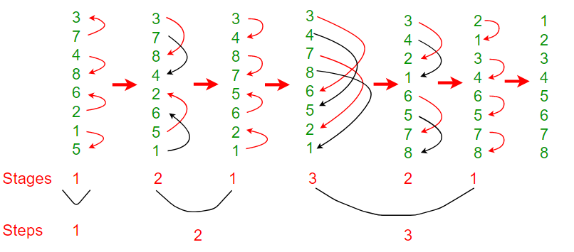
More intuition
Observe: 4 comparisons in each “step”, N / 2, same each time
Completely independent data in each step

Slide 47
Comparison to MergeSort
Why might Bitonic sort be preferred compared to Mergesort for parallel implementations?

Slide 48
Comparison to MergeSort
Why might Bitonic sort be preferred compared to Mergesort for parallel implementations?
Total task number changes at each state
Task granularity changes at each state
Merging cannot be parallelized
Temporary arrays have to be synchronized correctly

Slide 49
End of Tut 4
Slides are uploaded here after every session GDrive: drive.zhiheng.dev
Anonymous Feedback: feedback.zhiheng.dev
Time reserved for A2 & GPU questions :)
Attendance

